Slide 1
RecyclerView
Week 9

Slide 2
2.1 RecyclerView

Slide 3
Contents
What is a RecyclerView?
Parts of a RecyclerView

Slide 4
What is a RecyclerView

Slide 5
What is an RecyclerView?
It is a UI component that allows the development to create a scrolling list.
It is a ViewGroup used to render the data set with the help of adapter and viewholder

Slide 6
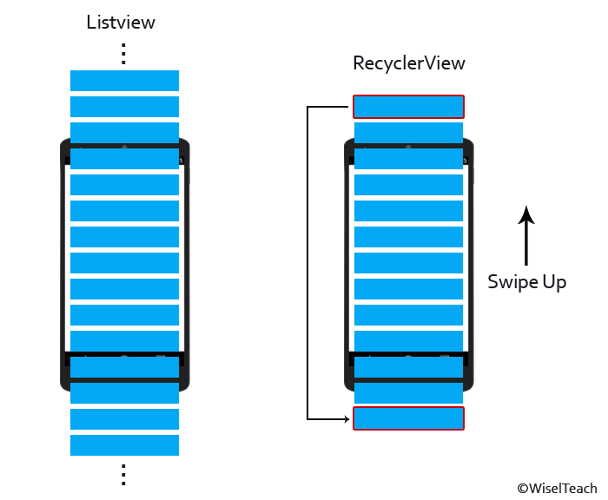
ListView vs RecyclerView

Slide 7
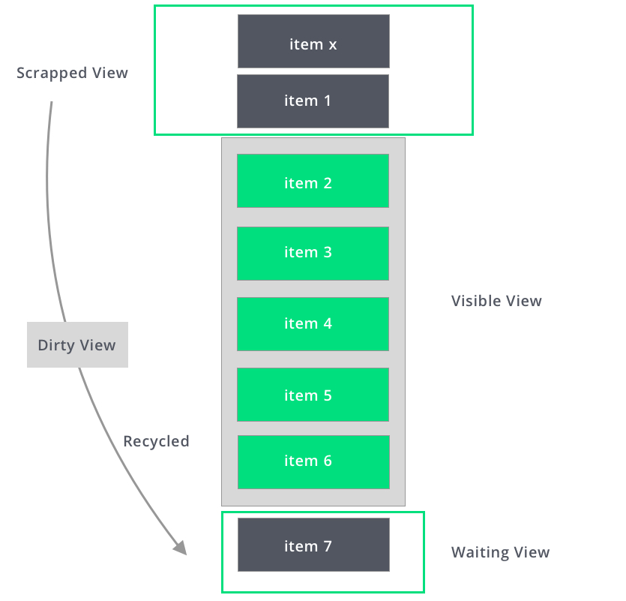

Slide 8
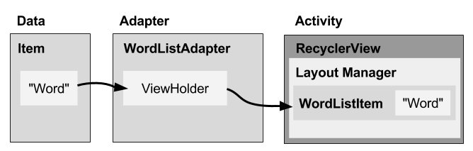
Components of a RecyclerView

Slide 9
RecyclerView
The main container, like the whole list or grid.
It displays items using the Adapter and LayoutManager.

Slide 10
ViewHolder
A wrapper around each item's view (like a row in the list).
It holds references to the views inside an item, like text or image views.

Slide 11
Adapter
The bridge between your data and the RecyclerView.
It creates ViewHolders.
It binds data to them (e.g., puts the right text in a TextView).
This is where we write code to decide how each item should look and behave..

Slide 12
Layout Manager
Controls how the items are laid out.
Types of Layout Manager:
LinearLayoutManager: shows items in a vertical or horizontal list.
GridLayoutManager: shows items in a grid (like a photo gallery).
StaggeredGridLayoutManager: like Pinterest-style uneven grids.

Slide 13
END

